Slide 1
Identifying Root Causes of Drug Addiction Using Explainable AI (XAI)
Final Defense
Shoaib Hossain
ID : 221-15-5949
Department : CSE
Daffodil International University

Slide 2
Outline
Introduction
Objective
Background Study
Gap Analysis
Methodology
Results & Analysis
Novelty of the Work
Conclusion
References
Final Defense

Slide 3
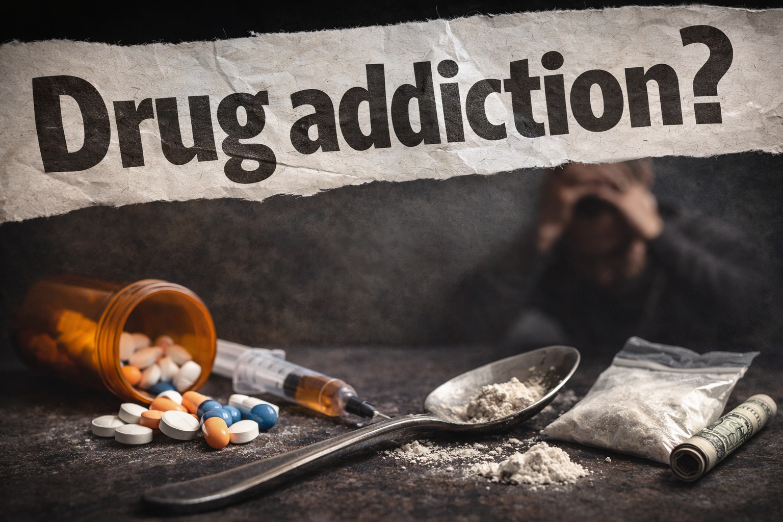
Introduction
What is Drug addiction ?
Drug addiction is a chronic brain disorder where repeated drug use creates strong cravings and makes it difficult to stop and Drug addiction is now a major global health crisis.
2023 (Global): 316M people (6%) used drugs
Bangladesh 2025: 8.3M people (4.9%) drug-dependent
Most affected age: 15–30
Final Defense

Slide 5
Objective
Identify key socio-economic, psycho-social, and environmental factors that influence drug addiction through comprehensive data analysis.
Apply Explainable AI (XAI) techniques to ensure transparent, interpretable, and trustworthy model decisions.
Develop evidence-based insights and strategies to support early prevention, risk detection, and targeted intervention for drug addiction.
Final Defense

Slide 6
Background Study
The Rising Crisis
Drug addiction is a global emergency.
Youth (15–30) are most affected in Bangladesh.
Rapidly increasing dependency.
Why Addiction Is Hard to Understand ?
Influenced by multiple factors:
  Socio-economic pressure
  Psychological stress
  Peer influence
  Family issues
  Easy availability
Final Defense

Slide 7
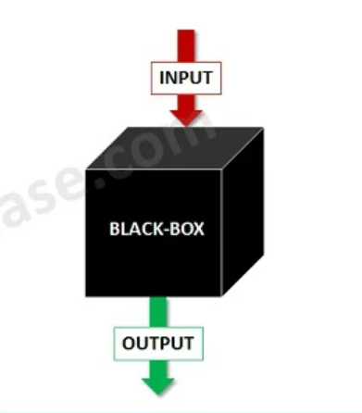
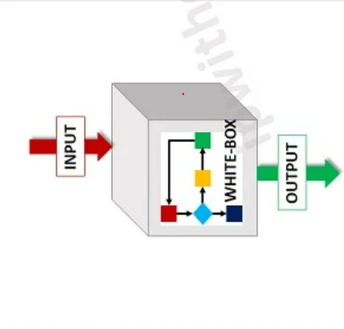
Continue..
Limitations of Traditional Approaches :
Only shows what is happening, not why.
ML works like a black box:
  No clarity
  No reasoning
  No policy-level insights
Why XAI?
Reveals root causes behind addiction.
Shows how each factor affects risk.
Ensures transparency & trust.
Provides evidence-based insights.
Final Defense

Slide 8
Gap Analysis
Existing Works
Most studies focus on prediction or detection of drug addiction using Machine Learning or statistical methods.
AI models used are often black-box in nature, lacking interpretability.
Research typically aims at classification, not understanding root causes.
Outputs are not actionable for health professionals or policymakers.
Identified Gaps
Root causes of drug addiction are rarely explored.
Explainable AI (XAI) is not commonly applied in addiction-related research.
Lack of transparency in AI decision-making.
Few studies are focused on the Bangladeshi context.
Our Contribution
Uses Explainable AI (XAI) (e.g., SHAP, LIME) to make model decisions transparent and understandable.
Focuses on identifying and interpreting key influencing factors (e.g., age, peer pressure, environment).
Applies analysis to real-world or localized data relevant to Bangladesh.
Provides actionable insights for use in healthcare and policymaking.
Final Defense

Slide 9
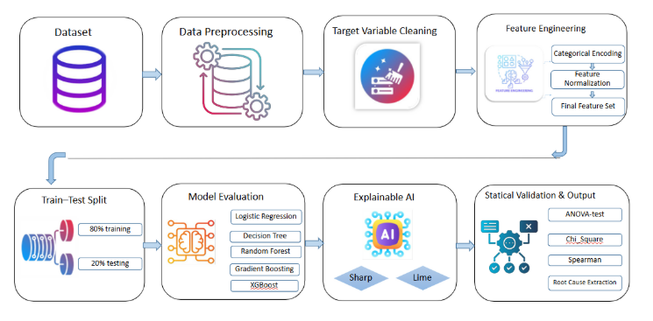
Methodology
Figure 1: Research Methodology Workflow
Final Defense

Slide 10
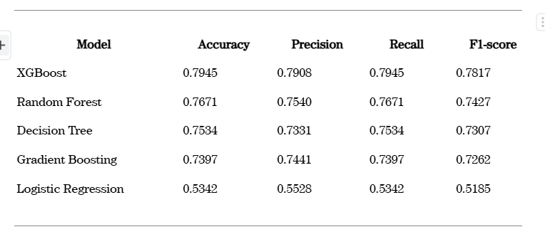
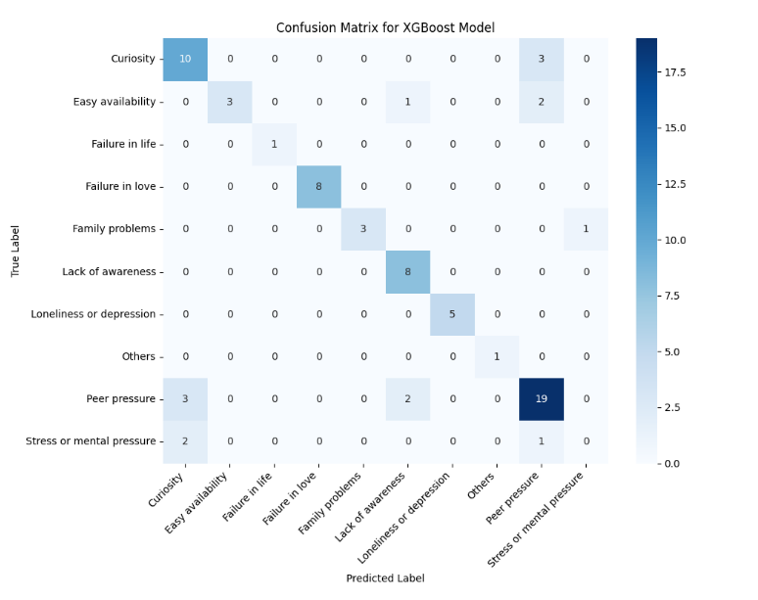
Result and Analysis
Model Performance Metrics
XGBoost achieved the highest accuracy, precision, recall, and F1-score, making it the best-performing model.
Ensemble models outperformed single models by learning complex patterns.
Logistic Regression showed the weakest performance.
Confusion Matrix Analysis (XGBoost)
Most predictions fall on the diagonal, indicating high correctness.
Major classes were classified accurately with minor confusion among similar categories.
Overall, the model shows strong and reliable classification performance.
Table : Model Performance Metrics
Figure : Best Model Confusion Matrix.
Final Defense

Slide 11
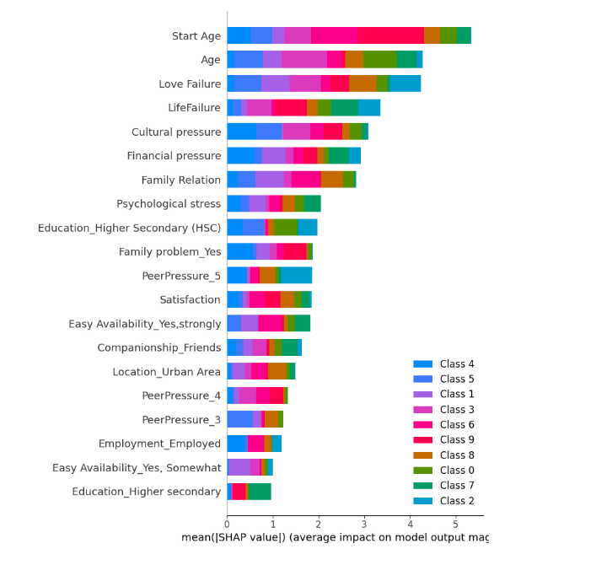
Continue..
SHAP Feature Importance
Start Age & Age: Strongest predictors of addiction risk.
Love Failure & Life Failure: Major emotional factors.
Cultural & Financial Pressure: Moderate influence.
Family Relation & Psychological Stress: Noticeable contribution.
Education, Peer Pressure & Easy Availability: Smaller impact.
XAI Insight
SHAP ranks features by importance clearly.
Model decisions are transparent and interpretable.
Objective Achieved
Major social, psychological, and environmental causes of addiction are identified.
Figure 3: SHAP Feature Importance
Final Defense

Slide 12
Novelty of the Work
Uses XAI to explain drug addiction risk, not just predict it.
Identifies root socio-economic, psychological, and environmental factors clearly.
Combines SHAP and LIME for transparent, trustworthy insights.
Provides actionable findings for early prevention and targeted intervention.
Final Defense

Slide 13
Conclusion
This study successfully identified the key socio-economic, psychological, and environmental factors that influence drug addiction.
Using Explainable AI (XAI), the model not only predicted risk but also clearly explained why the risk increases.
SHAP and LIME provided transparent insights into the root causes, making the results trustworthy and easy to interpret.
These findings can help in early prevention, risk detection, and targeted intervention strategies for reducing drug addiction.
Final Defense

Slide 14
References
[1] Md. A. Islam Arif, S. I. Sany, F. Sharmin, Md. S. Rahman, and Md. T. Habib, “Pre diction of addiction to drugs and alcohol using machine learning: A case study on ©️ Copyright 2024 Department of Computer Science and Engineering, Daffodil International University 13 FYDP (Phase-I) Progress Report [Version 1.0] Bangladeshi population,” International Journal of Electrical and Computer Engineer ing (IJECE), vol. 11, no. 5, p. 4471, Oct. 2021, doi: https://doi.org/10.11591/ijece.v11i5.pp4471-4480.
[2] A. K. Mohiuddin, “Drug Addiction in Bangladesh: ‘A Consequence of Social De moralization Rather Than Individual Flaws,’” International Journal of Addiction Re search and Therapy, 2019, doi: https://doi.org/10.28933/ijart-2019-11-1005.
[3] M. N. Shazzad, S. J. Abdal, M. S. M. Majumder, J. ul A. Sohel, S. M. M. Ali, and S. Ahmed, “Drug Addiction in Bangladesh and its Effect,” Medicine Today, vol. 25, no. 2, pp. 84–89, Feb. 2014, doi: https://doi.org/10.3329/medtoday.v25i2.17927.
[4] H. Huma et al., “An Explainable AI Approach to Predicting Psychoactive Drug Consumption in Bangladesh,” pp. 1–7, Sep. 2024, doi: https://doi.org/10.1109/com pas60761.2024.10796357.
Final Defense

Slide 15
THANK YOU
Final Defense

